Slide 1








Overview
Four supportive steps to help young children identify their feelings, learn healthy self-control and reduce challenging behavior.

Slide 2

FLIP IT can be used for:
targeted interventions for a child displaying specific behavioral concerns.
OR
every day minor challenges and conflicts with one child or with multiple children.
1
1

Slide 3
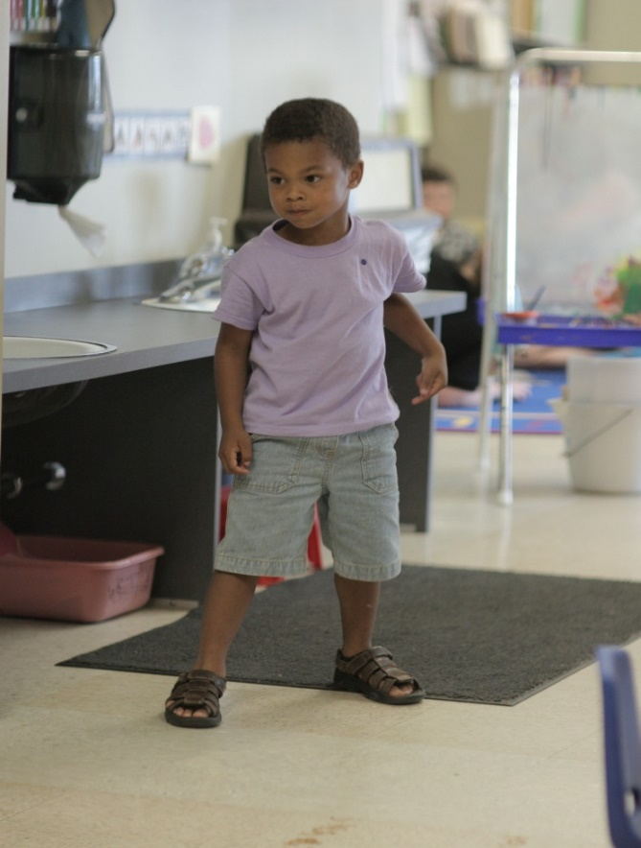
FLIP IT is:
Best practice made simple
Strength-Based
Commonsense
Effective
Portable
Easy to remember
Easy to share
Applicable in a variety of situations
Four simple steps
1-2

Slide 4
Four Steps
F
L
I
P
Feelings Limits Inquiries Prompts
2

Slide 5
FLIP IT Pre-Requisites
Relationships
Relationships are the foundation!
Every strategy is only as good as the relationship it is built on!
Empathy
Empathy is the ability to see and feel from another person’s point of view
The ability to honor “child-size” problems.
An understanding of ICK
Children are challenging when they are weighted down by something called ICK!
ICK refers to the negativity or risk factors in an individual’s life.
When times are full of ICK, we have a choice to stay calm and FLIP IT, rather
than FLIP OUT or FLIP IN (externalizing behavior or internalizing)!
6-9

Slide 6
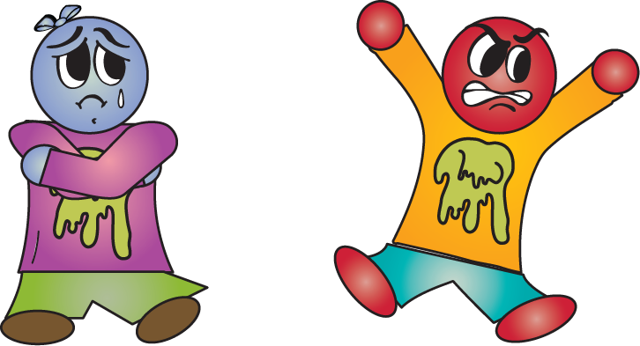
FLIP INs and OUTs
When children react to the ICK in their lives, they often FLIP IN or FLIP OUT.
FLIP INs happen when feelings stay inside and are not expressed.
FLIP OUTs happen when the negative factors children feel on the inside comes out in unhealthy or destructive ways.
10

Slide 7
Step 1 – FEELINGS
Defined
Begin the FLIP IT process with Step 1 – FEELINGS.
Gently talk with children about their feelings and what you are seeing and hearing as a result of their emotions. Help children identify the root feelings causing the behavior.
13

Slide 8
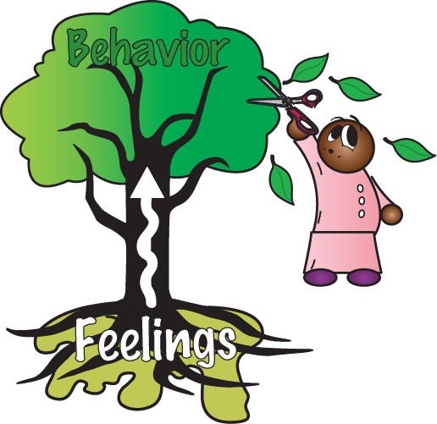
Sadness
Fear
Frustration
Anger
If we address the behavior without addressing the root feelings, the ICK will keep growing, and the negative behavior will reoccur.
14

Slide 9
How To…
“I see you are doing _____. I wonder if you are feeling _____.”
“Wow, it really looks like you are feeling _____.”
“I notice you are doing _____. What is going on inside?”
“Your body is getting antsy. Are you feeling nervous?”
“I’m so sorry you are feeling so _____.”
“What are you feeling?”
“Point to the face that tells how you are feeling.”
17

Slide 10
Step 2 – LIMITS
Defined
Once you have talked with a child about what she is feeling, proceed when necessary to Step 2 – LIMITS. Remind children of the positive limits and expectations you have for their behavior. Loving and simple limits help surround children with a sense of consistency, safety and trust.
23

Slide 11
Limits should be…
Positively worded
Kept simple
Descriptive
Stated without a “BUT”
Based on familiar rules
Reviewed during non-challenging moments
We keep ourselves safe
We keep each other safe
We keep our things safe
_____________
We use gentle touches
We use kind words
We listen with our eyes and ears
24

Slide 12
How to…
“I hear you saying unfriendly words. I wonder if you are feeling _____. We use friendly words here.”
“Wow, it really looks like you are feeling _____. We keep each other safe.”
“Your body is getting antsy. Are you feeling nervous? It’s okay to feel nervous.”
“I’m so sorry you are feeling so _____. We use gentle touches here.”
“I see you are excited about our visitor and you are running in the room. Our rule is to sit at circle.”
27

Slide 13
Step 3 – INQUIRIES
Defined
Once you have talked with a child about feelings and limits, move on to Step 3 – INQUIRIES. Encourage children to think about solutions to their challenges. Ask questions that promote problem-solving and healthy coping skills. Inquiries invite children to think, learn and gain self-control.
33

Slide 14

Let the child know you believe in her when you ask her to take part in finding a healthy solution (e.g., “What do you think you should do to get that toy back?”) Inquiries invite children to think, learn and gain self-control.
34

Slide 15
How to…
“How do you think we can fix this?”
“What could we do instead?”
“Is there another way?”
“How can we make this easier?”
“What else could we do to get us there?”
“What is a friendly way you could..?”
“What are we going to do to make this work?”
“How could we make this fun?”
37

Slide 16
Step 4 – PROMPTS
Defined
If the child is having difficulty problem-solving after you have talked with her about feelings and limits and have made an inquiry, move on to Step 4 – PROMPTS. Provide creative cues, clues, and suggestions for children having difficulty problem-solving. Enthusiastic, bright ideas can lead the way to better problem-solving skills.
41

Slide 17


Prompts are creative cues, clues, and suggestions for helping children find their own answer. Try…
Sharing personal examples (e.g., “When I get mad I like to scribble on paper.”)
Suggestions (e.g., “You might try using tape to put that back together.”)
Leading questions (e.g., “Hmm, I wonder if we could try walking backwards.”)
Positive choices where both options are desirable (e.g., “You could try warming your mittens on the heater or letting me put them in the dryer.”)
Use the child’s strengths and interests to spark his creativity (e.g., “Can we play some music while you clean up to make it more fun?”)
42

Slide 18
How to…
  “How do we think we can fix this? What could I get from my desk to help us put it back together?”
  “What do you think you could do instead? We could read or look for treasures in the room.”
  “Is there another way? I bet we can think of a way to make that stronger with more, hmm…more what?”
  “What else could we do to get us there? Could we walk backwards, or hop on one foot?”
  “What is a friendly way we can ask each other? Maybe a lower voice?”
  “How are we going to make this fun? Can we find a rock, leaf, and flower to bring back to the room?”
45

Slide 19
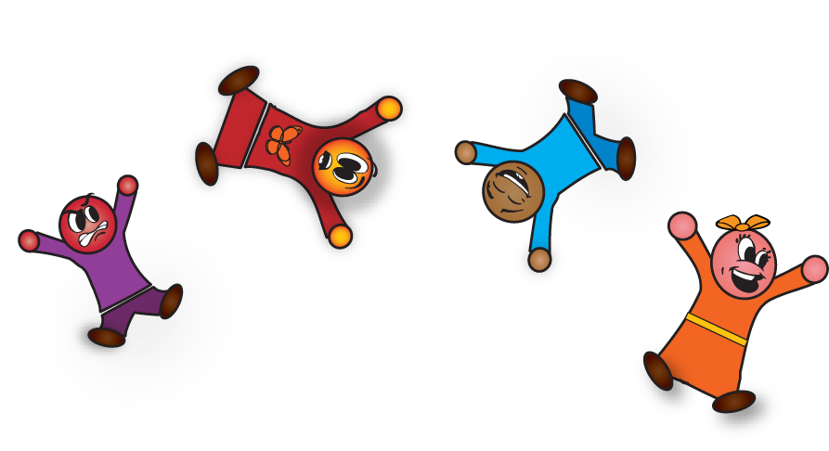
Children who are frequently “FLIPPED” become emotionally aware problem-solvers who develop healthy coping skills that will last a lifetime.
2

Slide 20

www.MoreFLIPIT.org
Answers to FAQs
Spanish translation
Testimonials
Online Course
Live Training
Train-the-Trainer
Free Resources
Order posters and more…
Professional Development & Training Available
For more information contact: Devereux Center for Resilient Children (DCRC)
444 Devereux Drive Villanova, PA 19085
Toll Free: 866-TRAINUS (872-4687) Email: DECA@Devereux.org www.CenterforResilientChildren.com

