Slide 1
Promoting Resilience in Preschoolers: The Devereux Approach
Celebration of Resilience
May 31, 2013
Villanova, PA

Slide 2
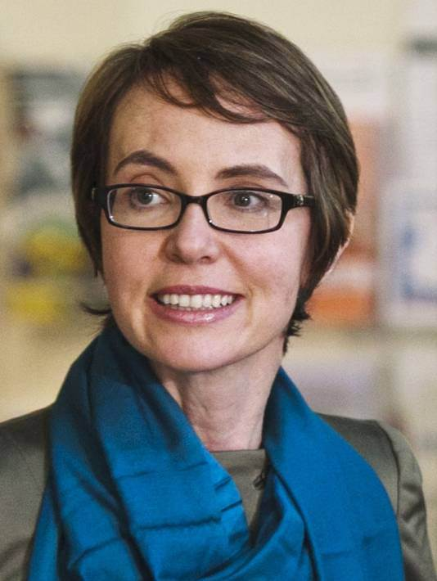
Gabrielle Giffords

Slide 3
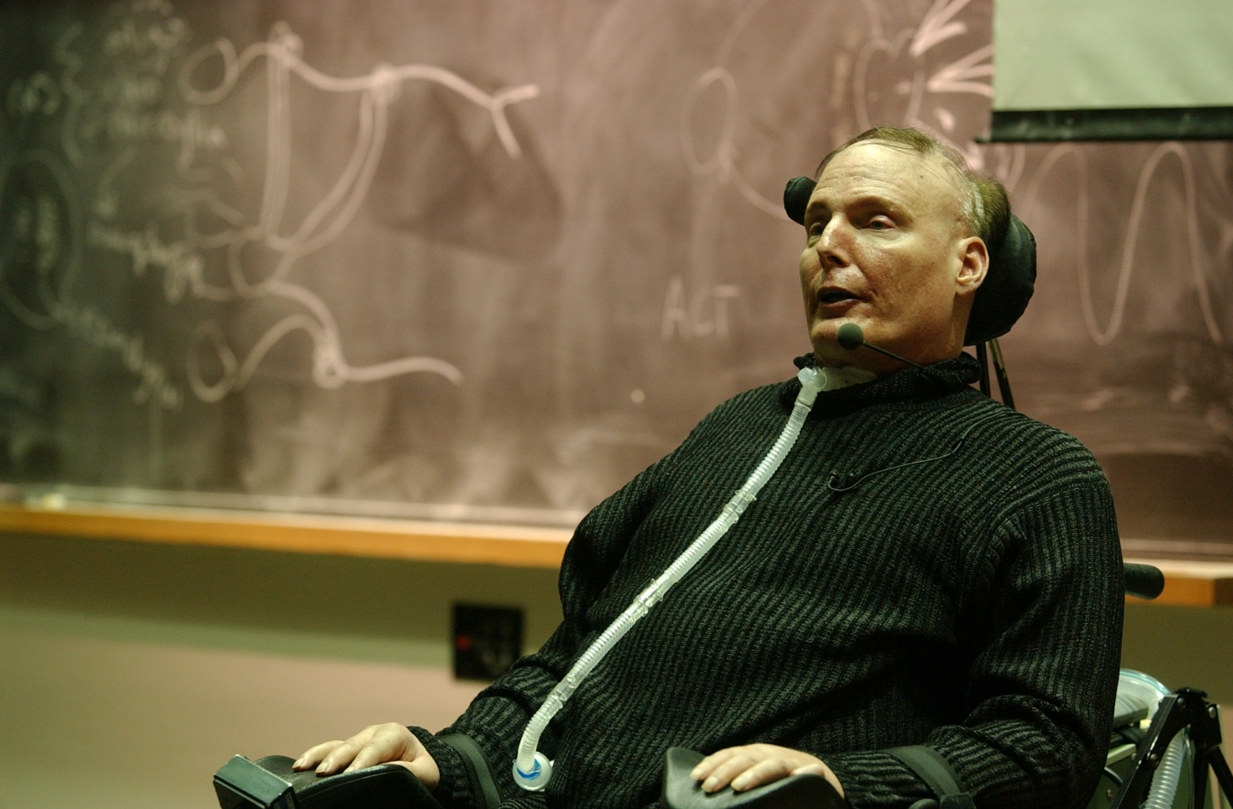
Christopher Reeve

Slide 4
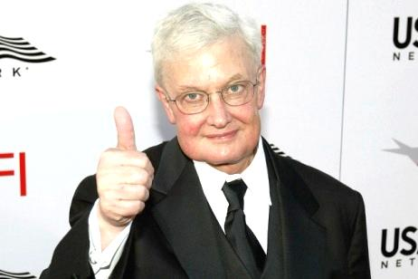
Roger Ebert

Slide 5
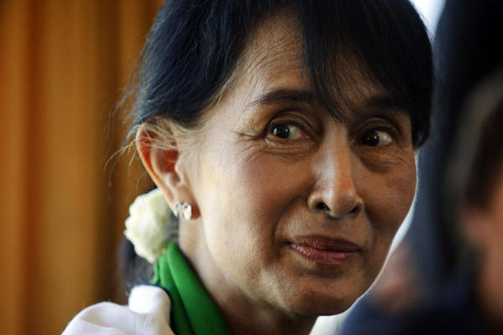
Aung San Suu Kyi

Slide 6
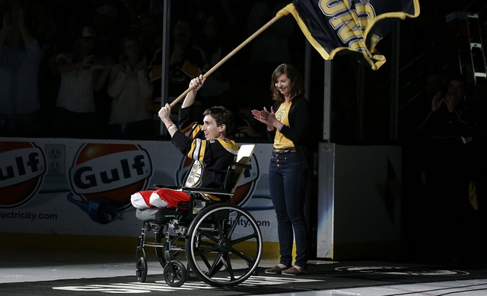
Jeff Bauman
Notes:
Bauman had just been blown up at the Boston Marathon. His photo became one of the most iconic of the attack, in part because the man in the hat, Carlos Arredondo, was already a famous peace activist and further because Bauman, when he came to, identified Tamerlan Tsarnaev for the FBI.

Slide 7
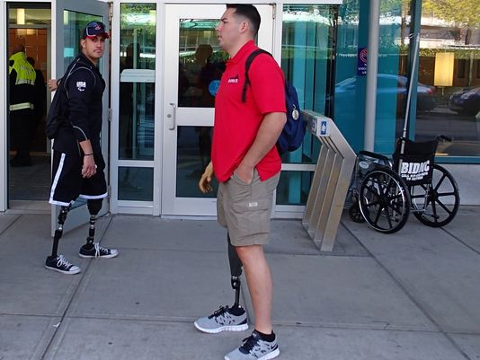
Cameron West
Gabriel Martinez
Notes:
Marine Capt. Cameron West, in the red shirt, and Gabriel Martinez, a retired Marine sergeant in the black shirt, wait for a ride after meeting amputee patients from the Boston Marathon bombing.

Slide 8
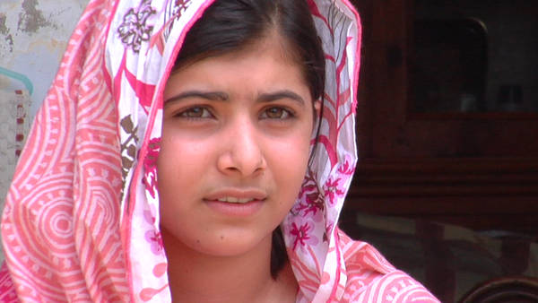
Malala Yousufzai

Slide 9
“Bounced Back” in the face of major life events

Slide 10
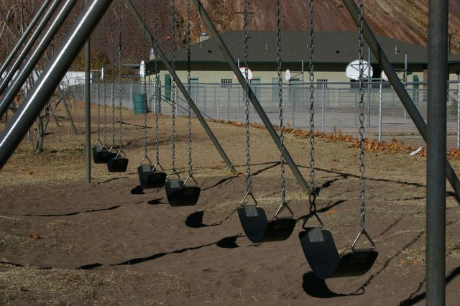
Poverty
Bullying
Academic Pressures
Low Quality Schools
Stressed Teachers
Unavailable Parents
Anti Social Peers

Slide 11
Two-thirds of children experience negative outcomes.

Slide 12
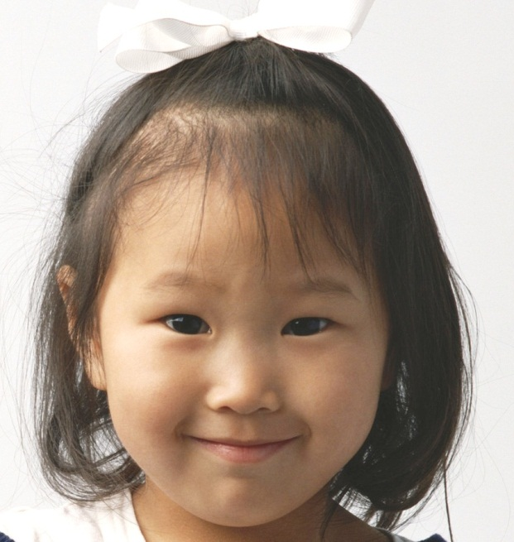
But one-third of the children do better than we have a right to expect in the face of these daily hassles.

Slide 13
How can we build a
system to promote children’s resilience?

Slide 14
Devereux’s Response
1996: Diversion – Prevention – Promotion
Grounded in theory & research
Strength-based
Malleable & Scalable
The 3 Rs
Rigor
Relevance
Realism

Slide 15
The Devereux Approach
Ecosystemic
Parents & Teachers
Data Driven - Based on assessment
That leads to strategies
That produce improved outcomes
Fit within existing systems

Slide 16
Risk and Protective Factors
Risk Factors
Protective Factors
Environmental
Environmental
Familial
Familial
Within- Person
Within-Person
Outcome
Vulnerability
Resilience
Notes:
SAMHSA, 2007 – “Successful promotion and prevention efforts hinge on the identification of malleable risk and protective factors.” p. 7
Risk cascades and maladaptation – conduct disordered youth – Webster Stratton
PF cascades?? bonadaptation

Slide 17
Protective Factor Definitions
Initiative- The child’s ability to use independent thought and action to meet his or her needs
Self-Regulation- The child’s ability to express emotions and manage behaviors in healthy ways.
Attachment/Relationships- The child’s ability to promote and maintain mutual, positive connections with other children and significant adults
Notes:
The first within-child protective factor that is measured and strengthened by the DECA-P2 program is Initiative.
(Show Ps the definition and read).
On the following slides, we are going to see behaviors that help us to measure this protective factor of Initiative in a young child. All of the following items are actually on the DECA.

Slide 18
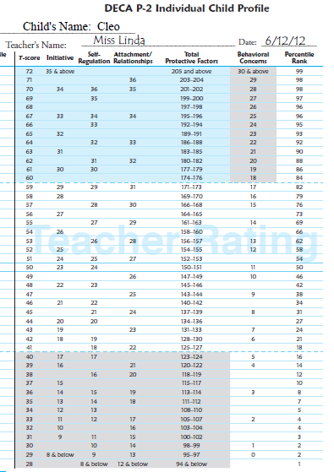
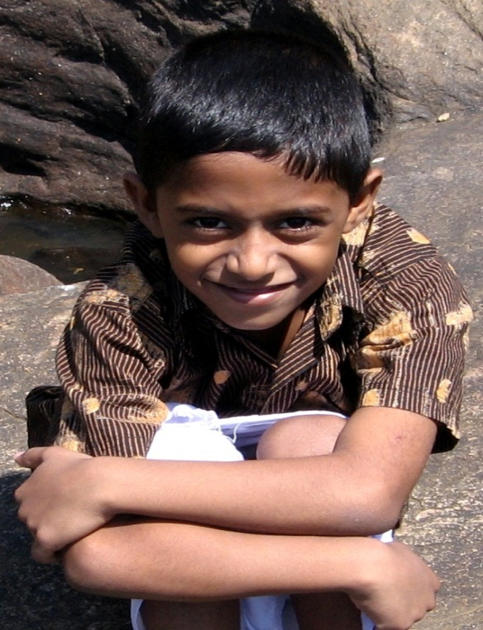
Rigorous Assessment
IN
SR
A/R
TPF
BC
Strength
Area of Need
Cleo’s Profile
Typical
Typical
Area of Need
Notes:
Cover up the four protective factor circles and ask the group “what would we know about Cleo if we hadn’t completed the DECA on him?” We wouldn’t know a lot due to the fact that Cleo isn’t displaying behavioral concerns. However, by looking at scores, we know he is at risk.
Ask participants “What do you think will happen if Cleo is faced with stress and/or adversity in his life?” Participants say that they will see an increase in behavioral concerns. Reemphasize that at this point in time, Cleo does not have strengths to draw upon to help him with stress. This is why we do a DECA on every child - to help identify low protective factors before concerns emerge. We want to build Cleo’s protective factors so that if/when faced with stress/adversity, he will have resources on which to draw. A teacher could take results from this profile and use strategies to help Cleo build his protective factors and prevent behavior concerns.
Ask Ps- if you were only singling out 1-2 children in the classroom on which to do the DECA, would you choose Cleo? Most likely, No. This is one of the reasons you should Universally screen all the children’s strengths using the DECA. Children likes Cleo may “slip through the cracks” as their Behavioral Concerns are not yet a concern for us.
18

Slide 19
Leading to Practical Strategies

Slide 20
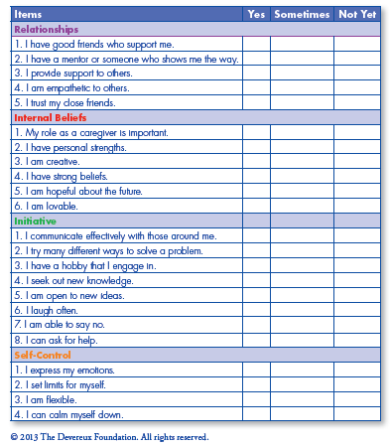
Implemented by Resilient Adults

Slide 21
The right place at the right time

Slide 22
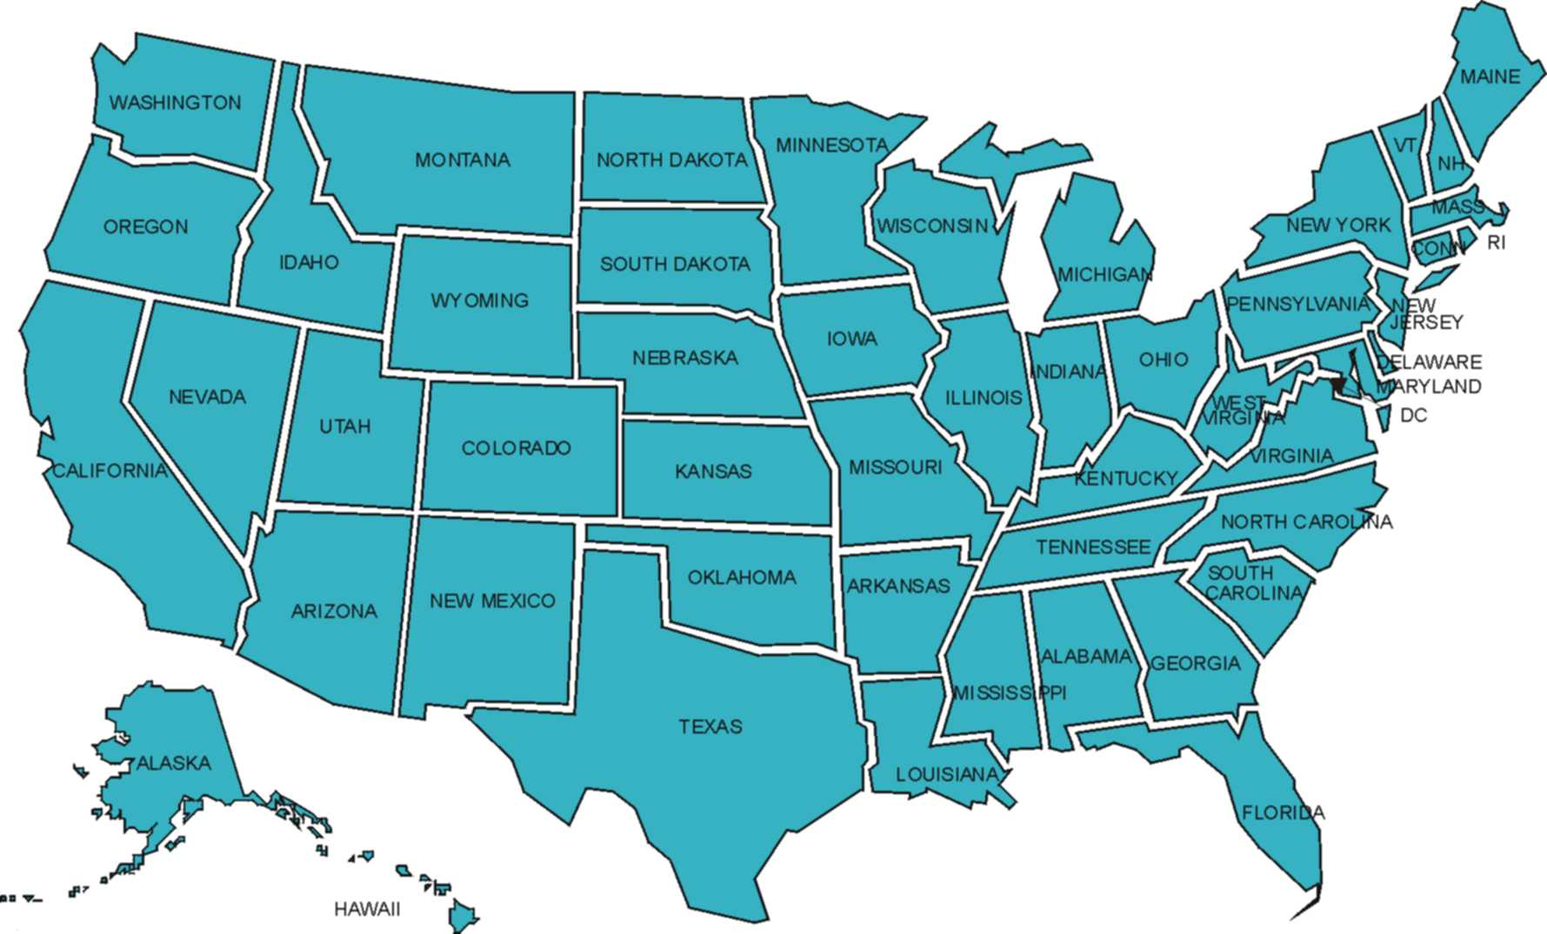
National Impact
4,000,000 Children
5,000 Programs
All 50 States

Slide 23
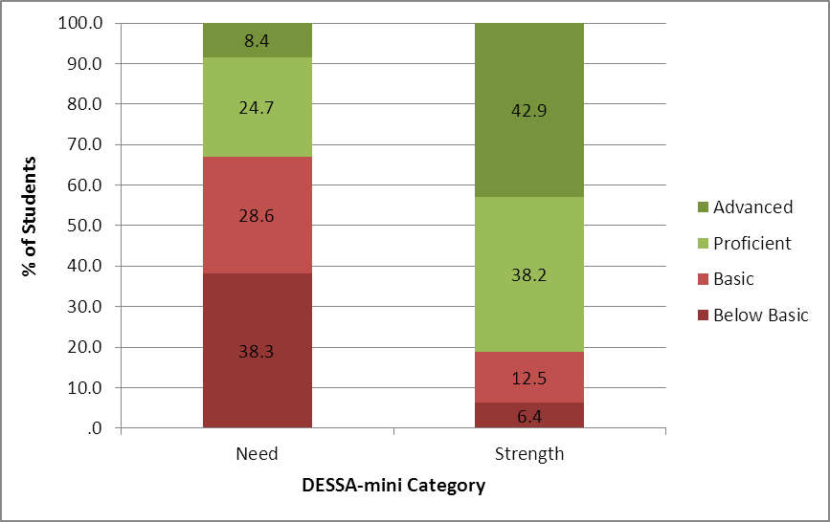
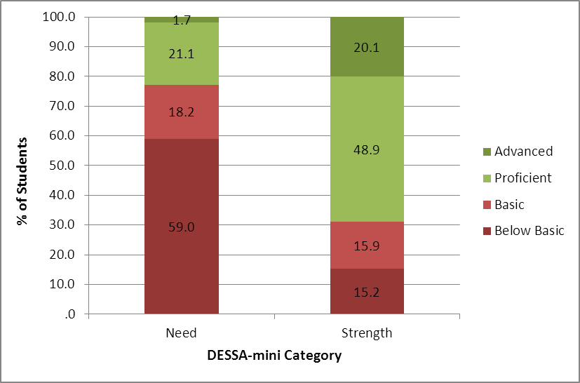
Promoting Success in School & Life
% of Students by PSSA Math and DESSA-mini Categories
% of Students by PSSA Reading and DESSA-mini Categories

Slide 24
Promise of Prevention
N = 406 | % Pre Behavioral Concerns | % Post Behavioral Concerns
Strength on pretest Total Protective Factors (n = 76) | 0% | 0%
Typical on pretest Total Protective Factors (n = 275) | 14% | 13%
Concern on pretest Total Protective Factors (n = 55) | 51% | 70%

Slide 25
DCRC Mission
Our mission is to promote social and emotional development, foster resilience, and build skills for school and life success in all children birth through school-age, as well as to promote the resilience of the adults who care for them.

Slide 26
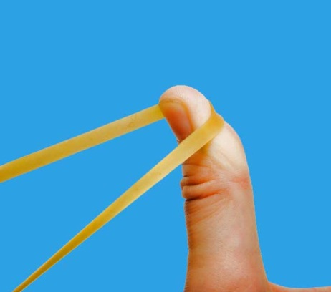
Resilience
the ability to succeed in the face of hardship
Notes:
In fact that directionality may make us think about positioning the text on this slide here, where it plays with the graphic.
10

Slide 27
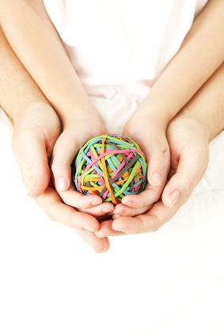
Thank you for joining us today and sharing our commitment to promoting children’s resilience!

Slide 28
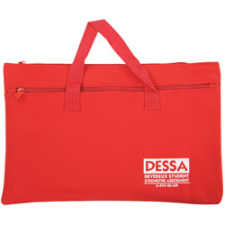
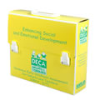
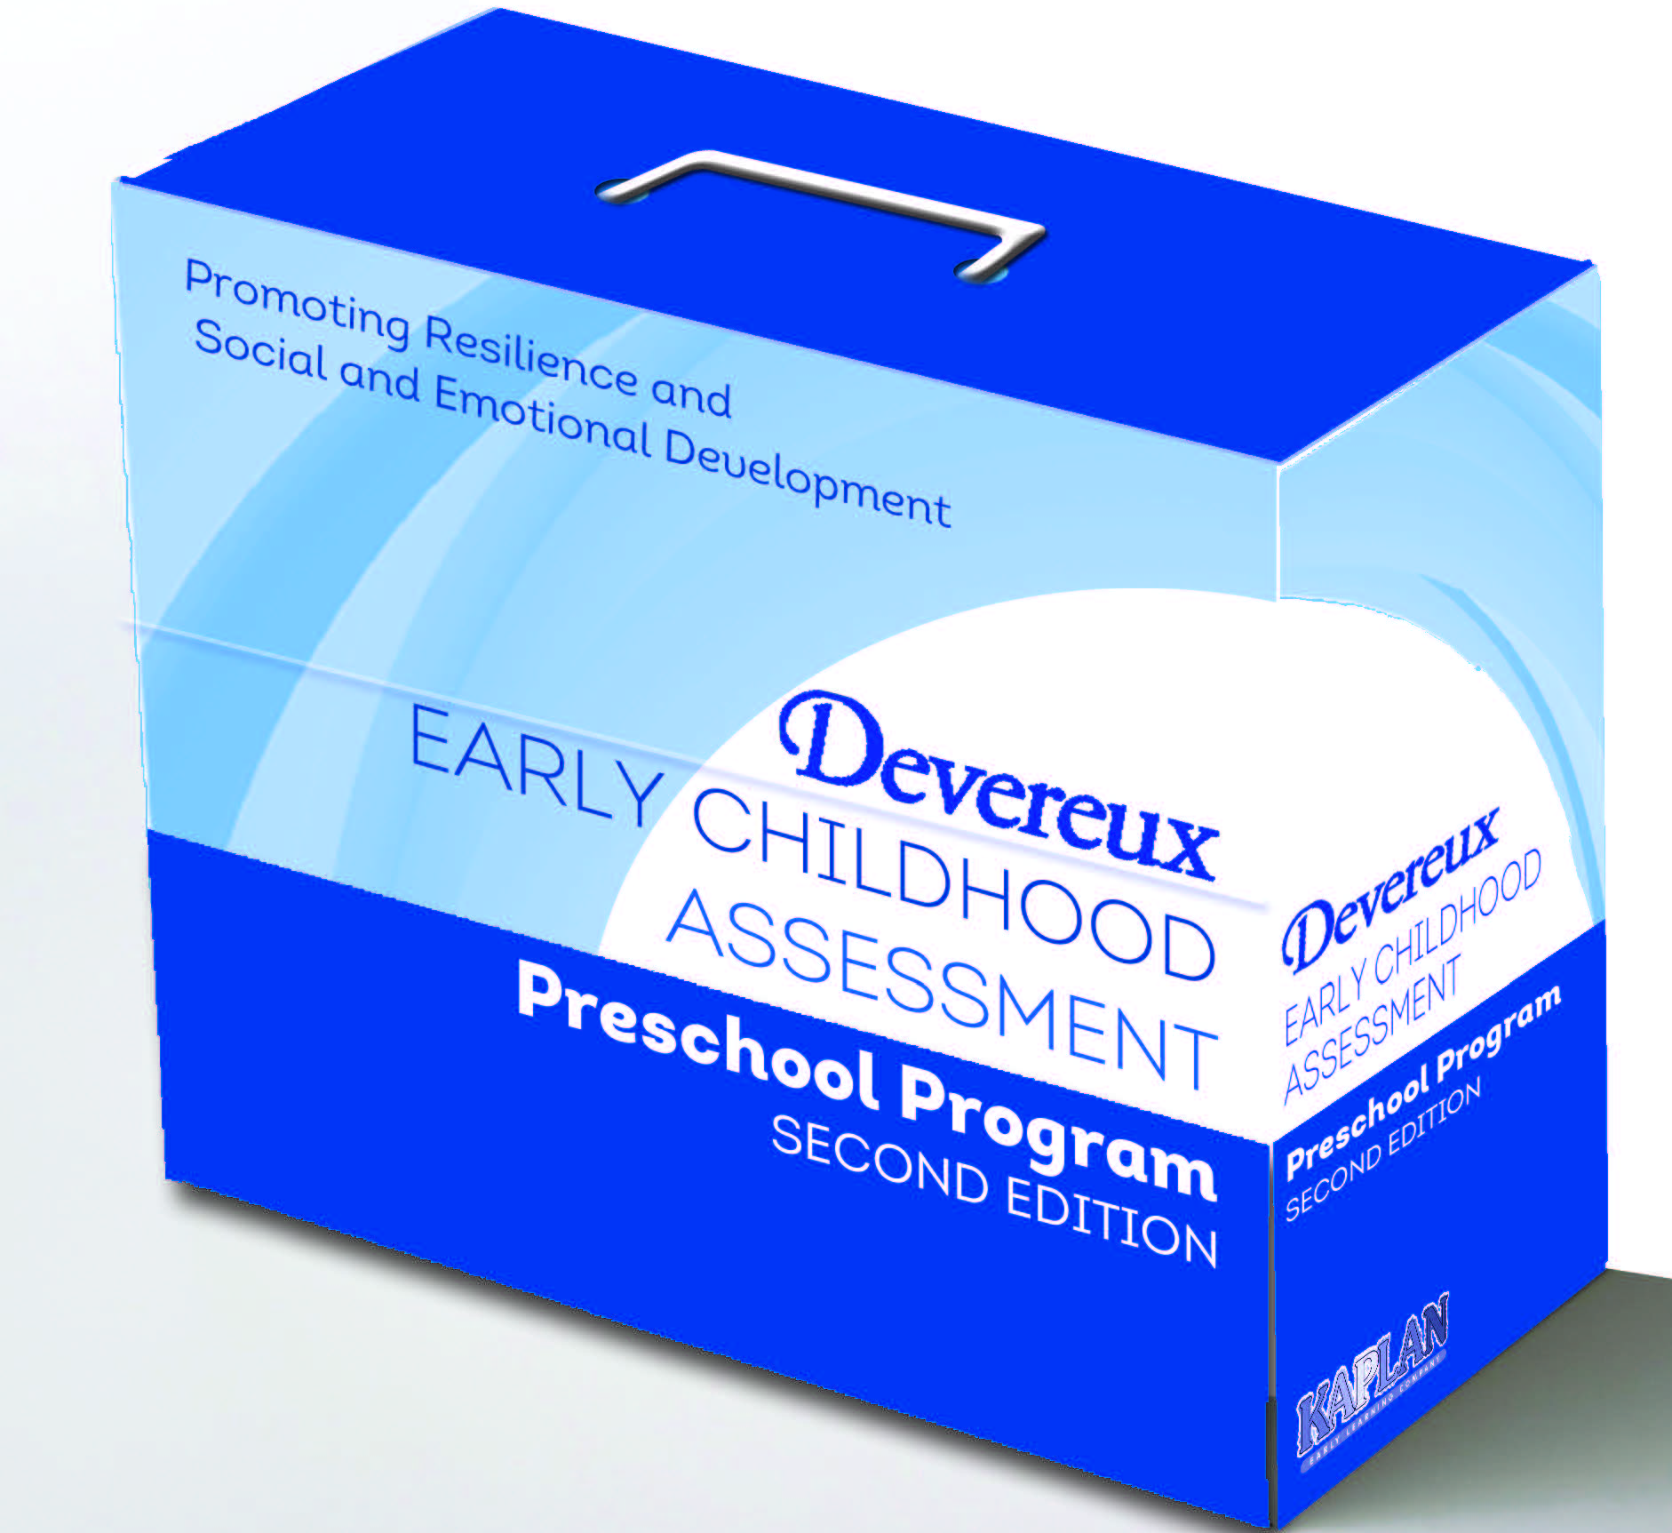
The DCRC Continuum of Resilience-based Assessment and Planning Resources
Infant & Toddler
School-Age
Preschool
Adults
Notes:
In this revision, I used your color coding system to better pair the labels with each picture. Then I grouped the picture and label by placing them nearer to each other and further away from the other pairs. I liked the idea of every pair being in one horizontal row to better show a continuum, but I couldn’t get everything to fit. As it was, I went to your site and pulled down simplified pictures of the infant and toddler and preschool kits because the extra details about kit contents were just too much for the slide. But still, it was too scrunched to get everything into one row. So we have a two by two grid for the items in the middle.
And then I relied on the gray you use on your site for the background of the title bar so that it represented your larger company, not just the preschool component.

